Slide 1

Changes I have made for local analysis
Separating Francis’ “Control” and Katie’s “T1”

Slide 2
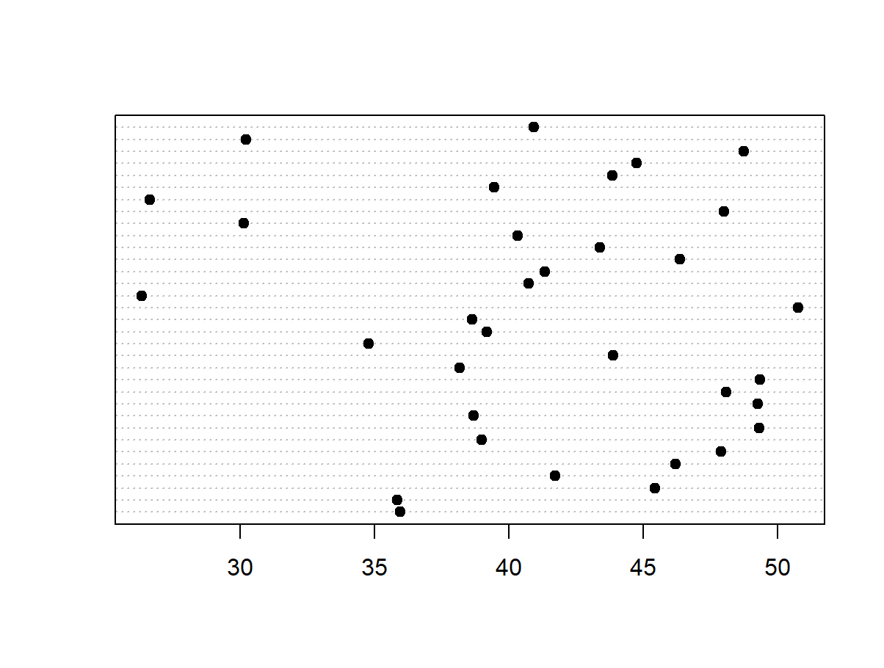
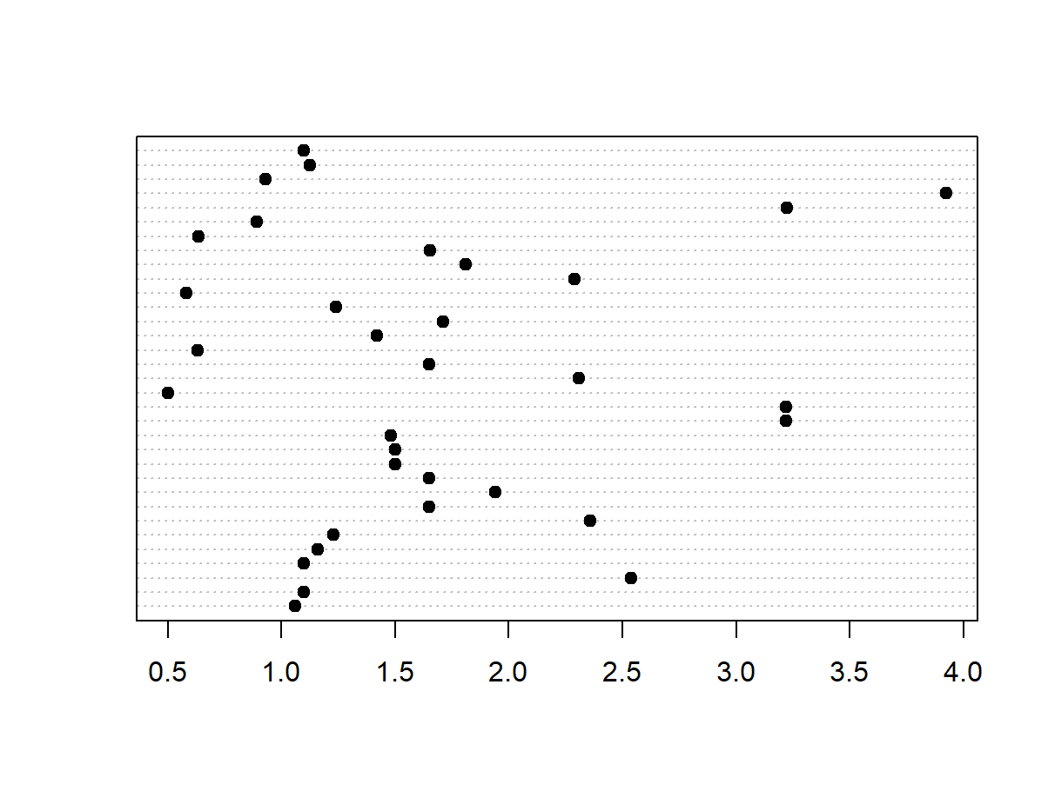
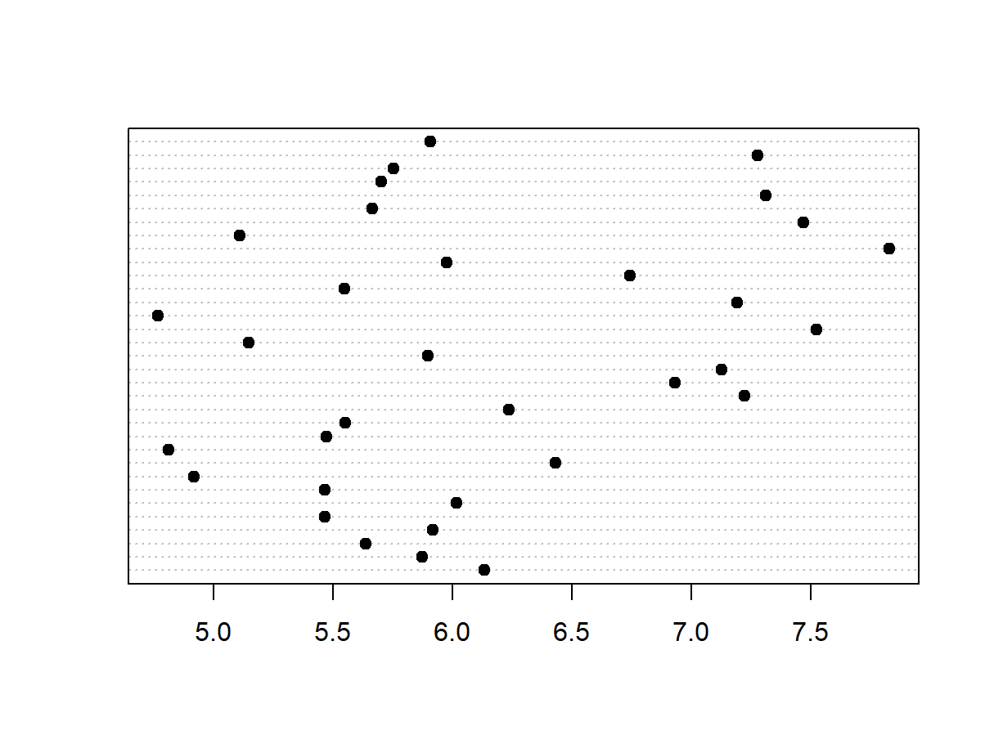
Relationships among landscape vars dotchart(land$#var#, pch = 19)
ENN
LPI
I think it’s fine still?

Slide 3
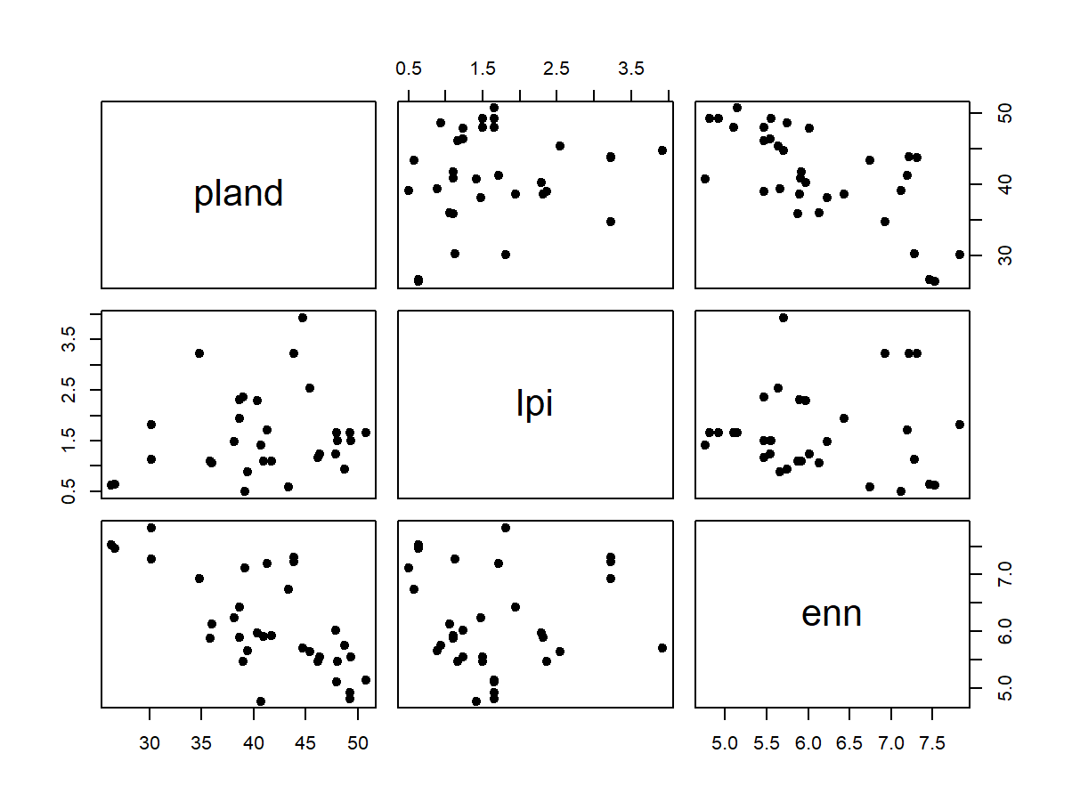
pland lpi enn
pland 1.0000000 0.1819472462 -0.6958556927
lpi 0.1819472 1.0000000000 0.0008583432
enn -0.6958557 0.0008583432 1.0000000000
plot(land[2:4], pch = 19)
cor(land[2:4], method = c("pearson"), use = "complete.obs")

Slide 4
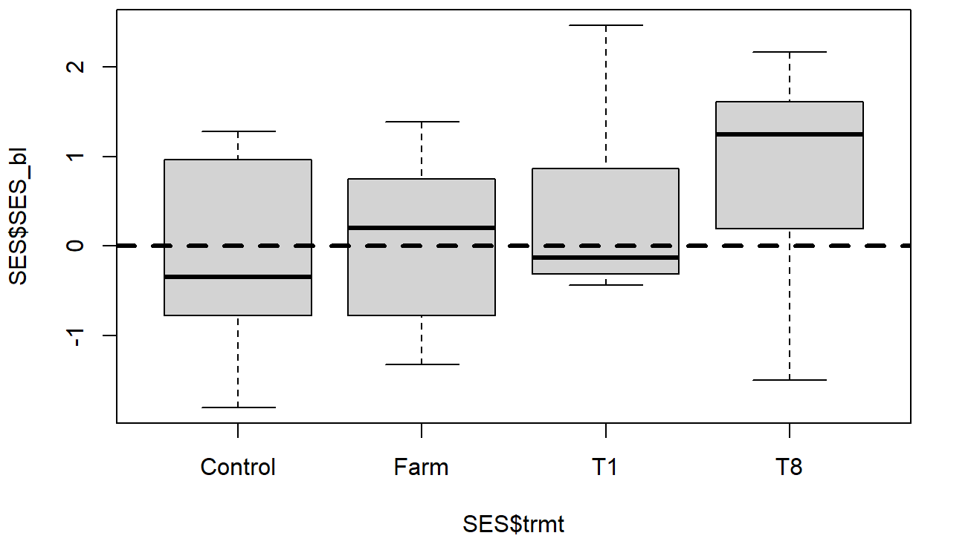
Body lengths vs Null

Slide 5
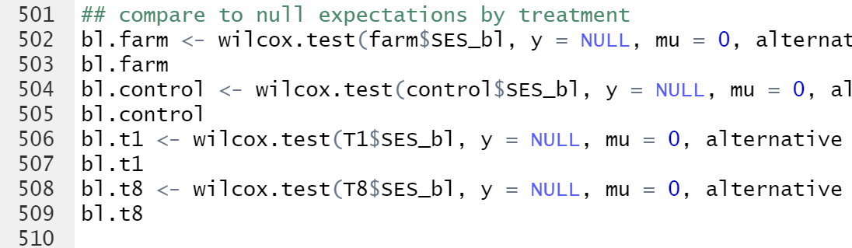
Separated Francis and Katie’s control/T1s
Or

Slide 6
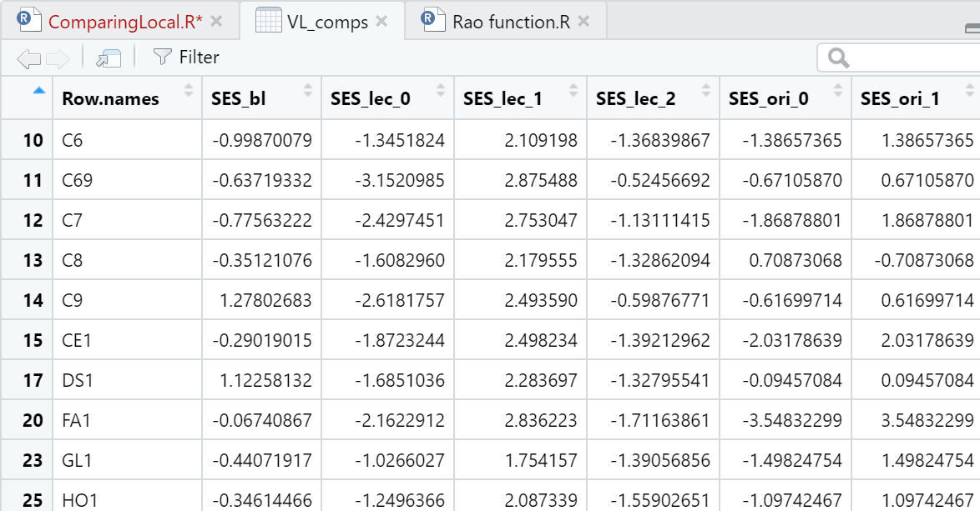
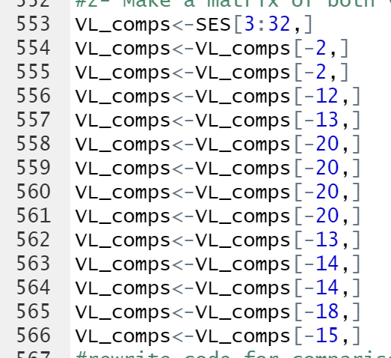
Then created Matrices for Francis, Katie, and VLs

Slide 7
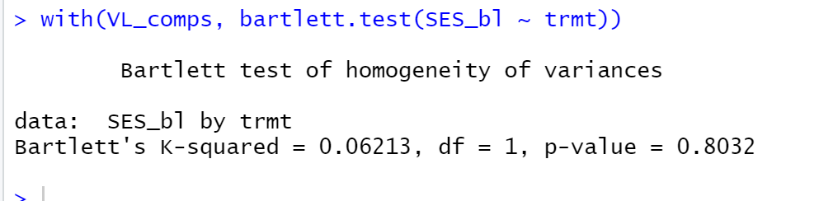
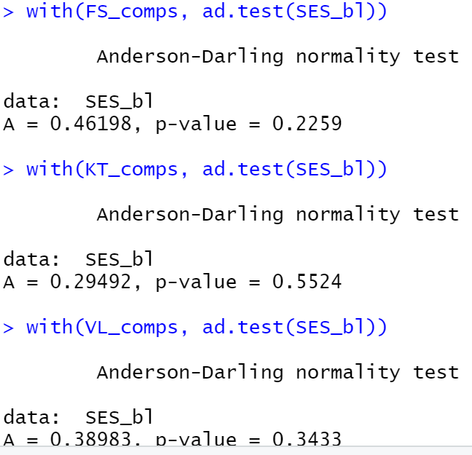
Homegenity and Normality
For Bartlett:
All had over a p value of .5
So all groups had homogenous variance
Anderson Darling Normality test:
All p values over .2
So the data is normal

Slide 8
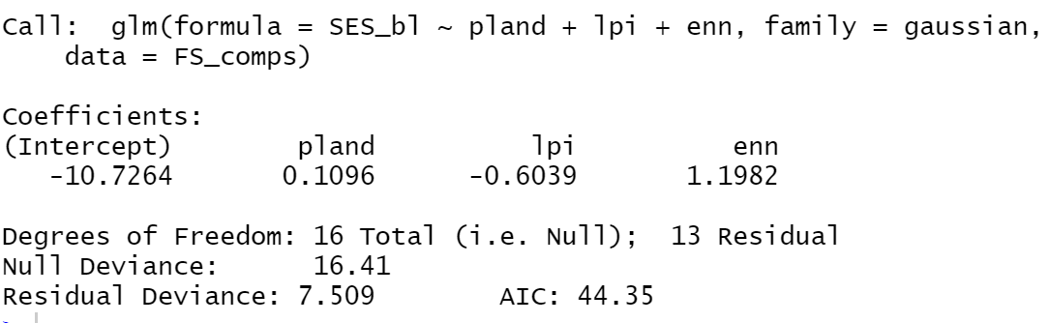
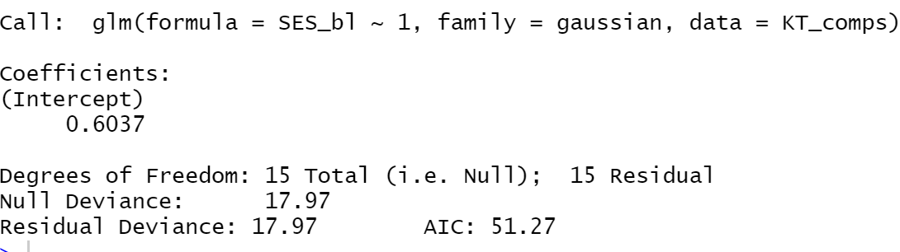
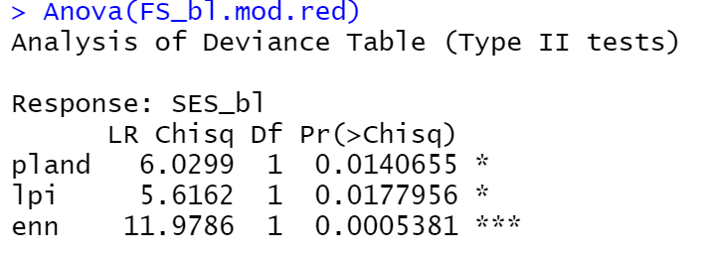
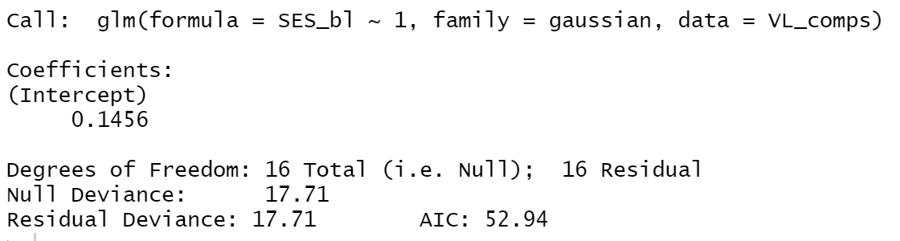
Oh GLM for body length is no longer only intercept
PLAND, LPI and ENN matter for Francis

Slide 9
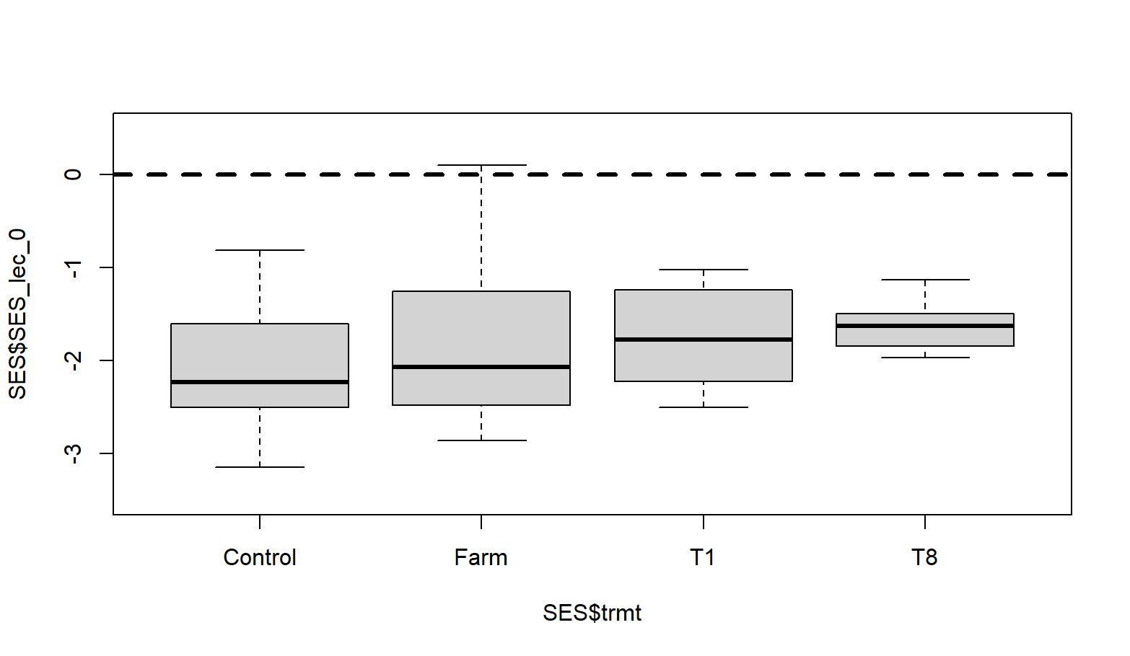
Kleptoparasites seem unchanged

Slide 10
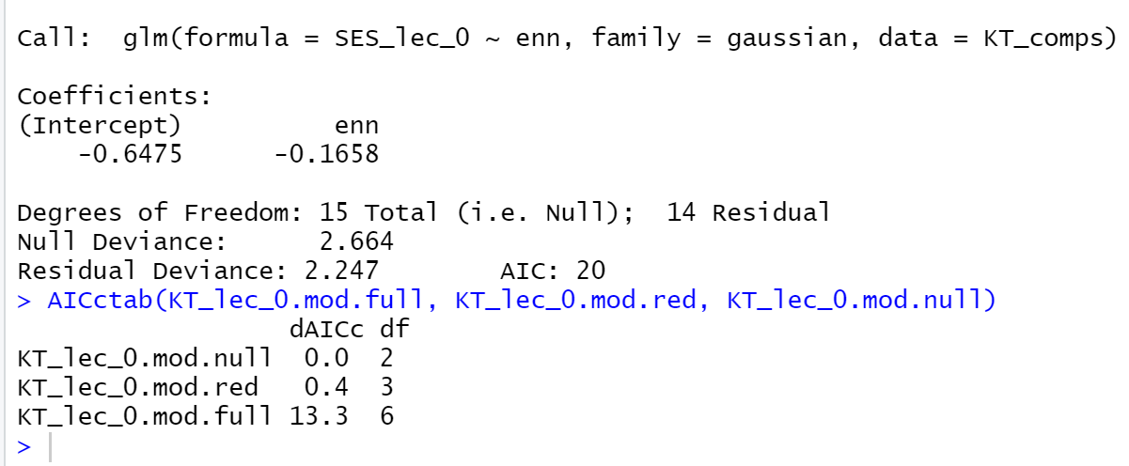
Kleptoparasites- Katie and VL results are odd?
The step function said that enn was a predictor. (for katie, for VL 3 things were)
AIC said null model was best predictor
Going with intercept for now

Slide 11
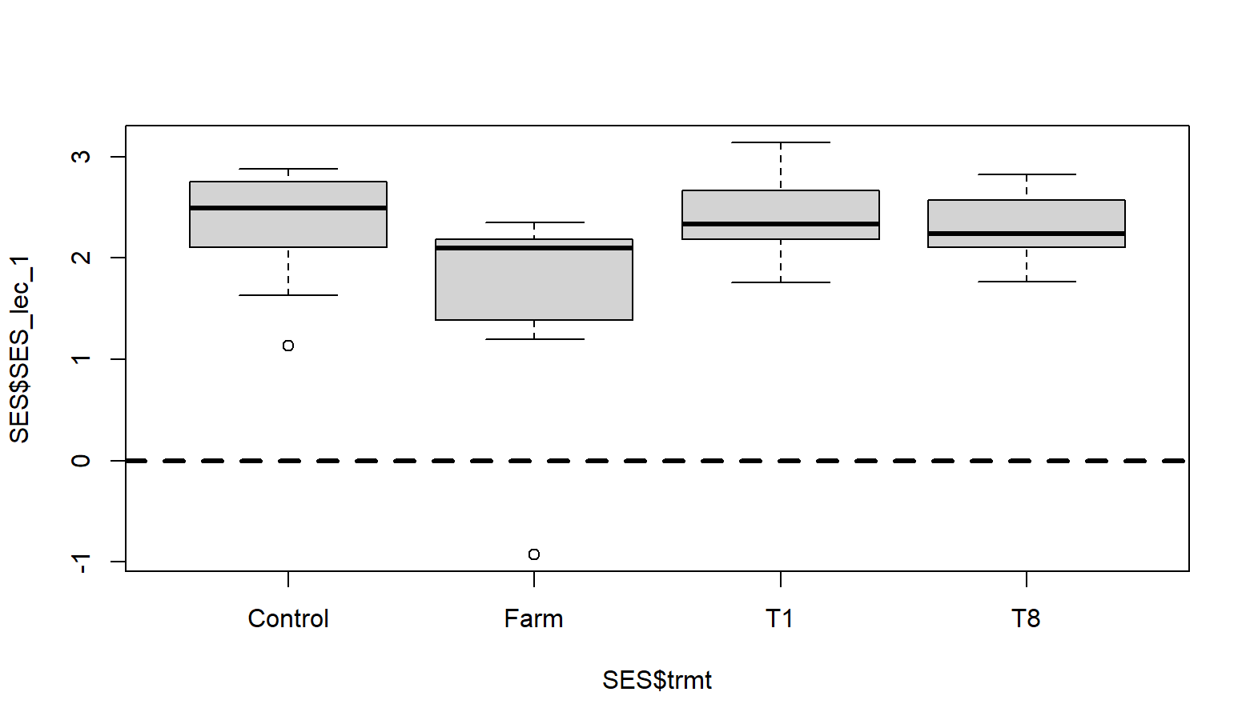
Generalists are doing just fine

Slide 12
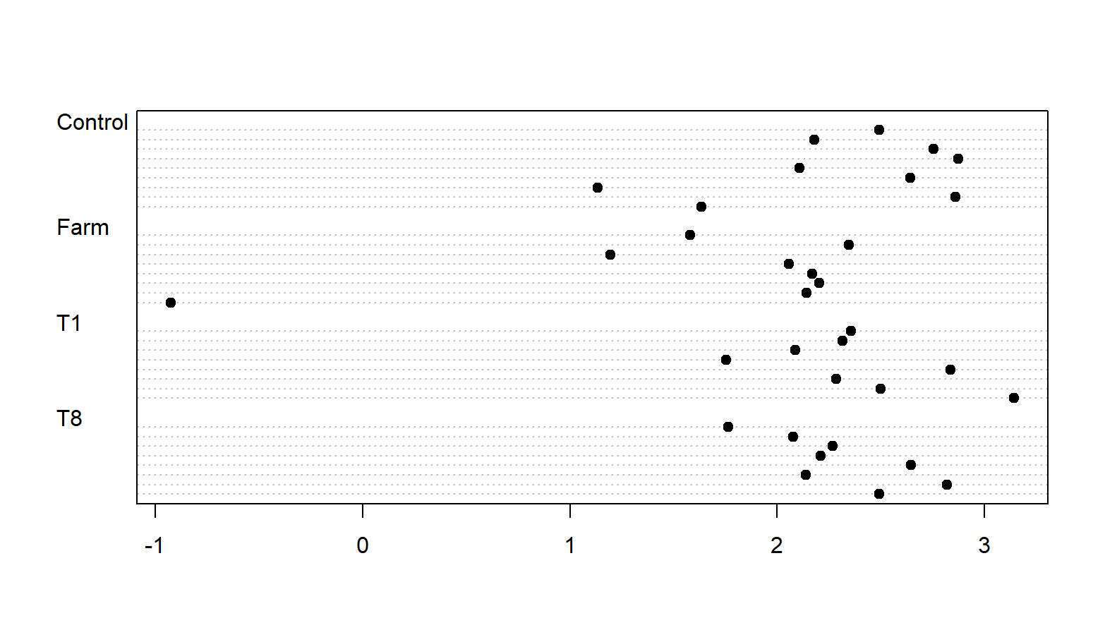
Francis’ data fails Anderson Normality test
I’m guessing because of that outlier farm?

Slide 13
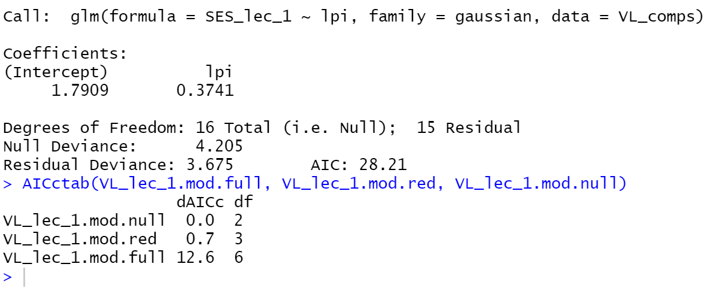
Once again step and AICc disagreed

Slide 14
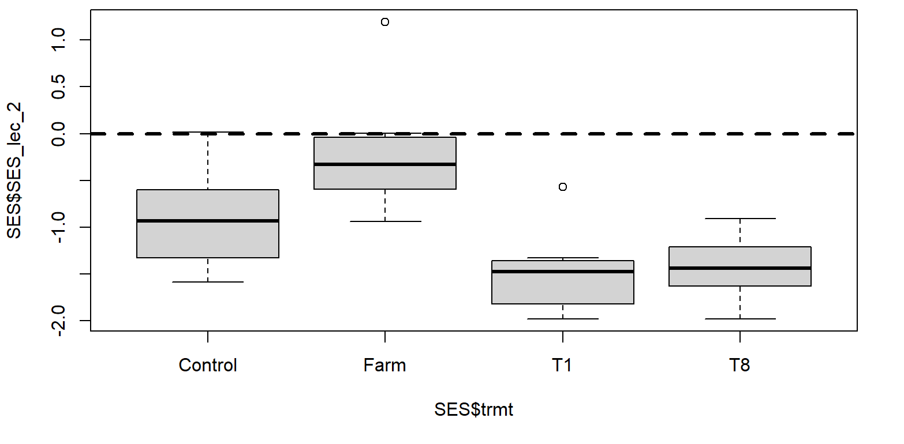
On to specialists

Slide 15
Once again AIC vs. Step was different
0 vs. 0.4 for AICc value.

Slide 16
Have 1 slide- all bees did this,
Have one slide all bees did this
Then go into detail

Slide 17
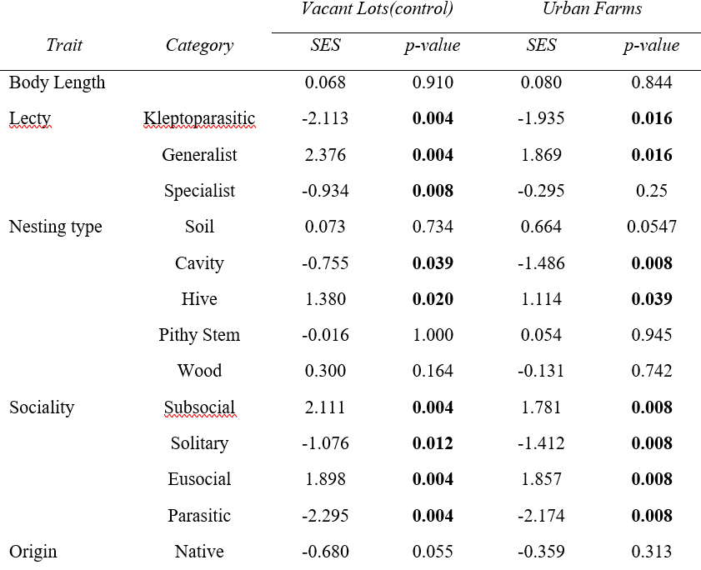
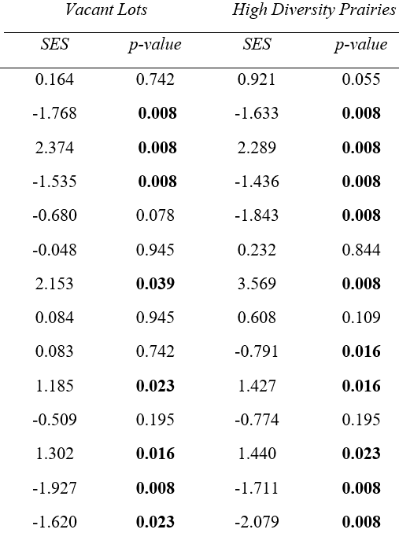




Okay final tally of differrences

Slide 18
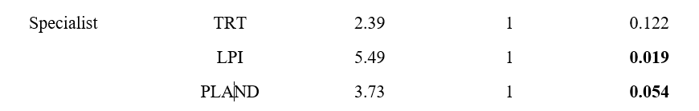

Specialists
FS
KT
VL comparisons

Slide 19
Soil

Slide 20
cavity

Slide 21
wood

Slide 22
solitary

Slide 23
native

